Slide 1
Data Analyst Professional Practical Exam Submission
Oh Boon Long
24 Jul 2024

Slide 2
Agenda
Overview of the project
Business goals
Summary
Key findings
Recommendations

Slide 3
Business Goals
Currently, the sales team are using 3 sales strategy to increase the revenue and the number of items bought.
Call
Email
Email + Call
The sales team need a sales strategy for the new product line. The sales strategy will be based on the insights gathered from analyzing the data related to the new products sold.
How many customers were used for each approach.
What does the spread of the revenue look like overall, and for each sales method.
Find if there are any difference in revenue over time for each of the methods.
Based on the insights, recommend a method for the sales team to use.
Reduce the time spent on ineffective sales strategies.

Slide 4
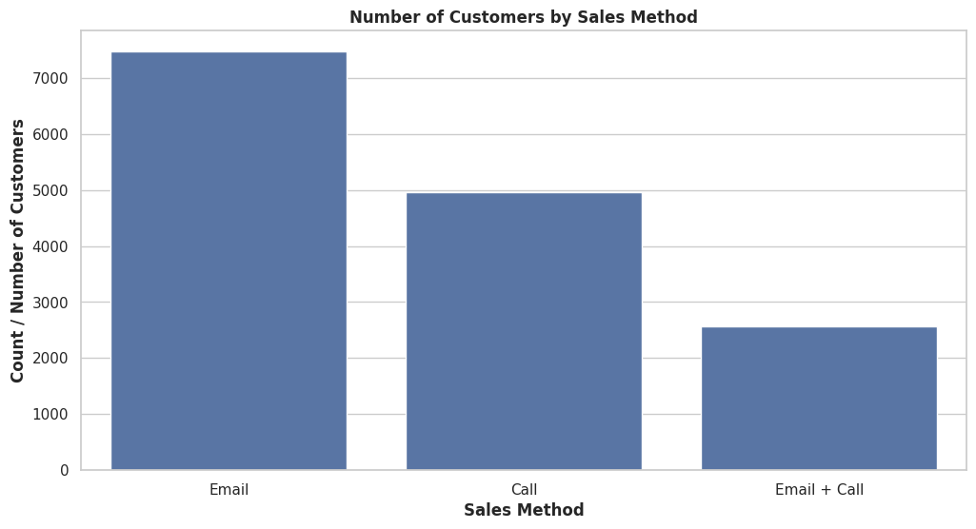
Summary of Key Findings
From the last 6 weeks' record of a new line of office stationery launch, out of the 15,000 customers:
50% were approached by email.
33% were approached by phone.
17% were approached by both email and phone.
This indicates that the email approach was the most commonly used by the sales team, followed by the phone approach.

Slide 5
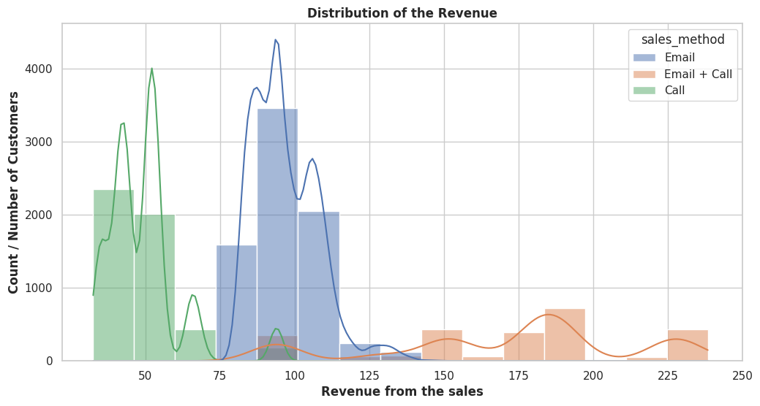
Summary of Key Findings
Conclusion:
The majority of customers approached by email or call tend to spend lower amounts (up to $140). There are fewer customers approached by email and call who spend higher amounts ($150 to $240). This indicates that the customers approached by email or call tend to spend less compared to those who spend more when they are approached by email and call.

Slide 6
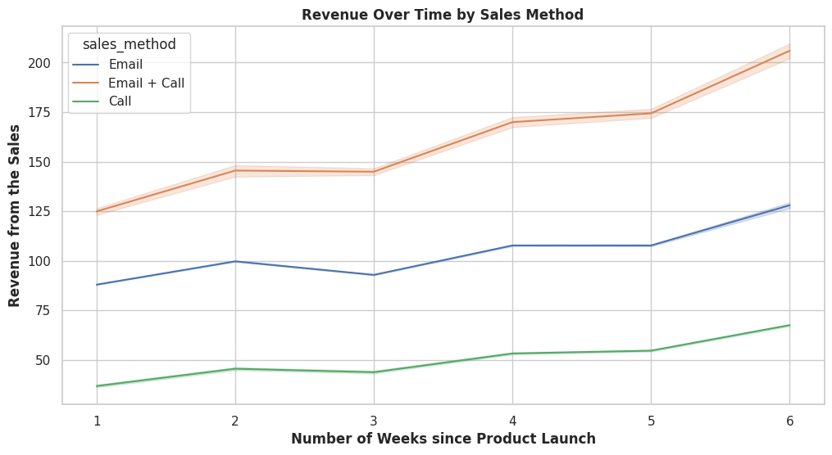
Summary of Key Findings
Since the start of the new product launch, there has been an increase in revenue across all three sales methods over the last 6 weeks:
The revenue from customers approached by call increased by $31.
The revenue from customers approached by email increased by $40.
The revenue from customers approached by both email and call $81.
This indicates that the combined approach of both email and call resulted in the highest increase in revenue.

Slide 7
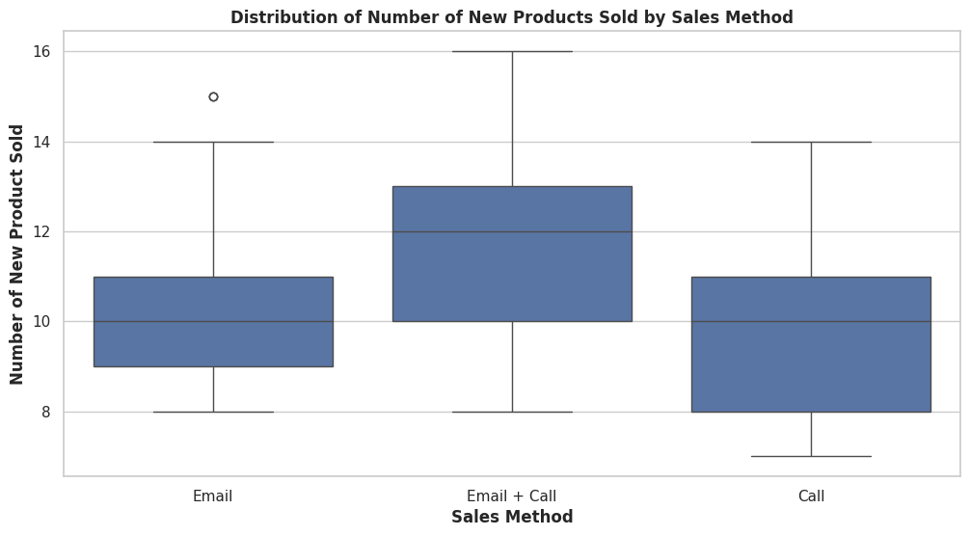
Summary of Key Findings
75% of the customers approached by both email and call bought 2 more items than 75% of the customers approached by either email or call alone.
The median number of items bought by customers approached by email and call is 12 items, compared to a median of 10 items for customers approached by either email or call alone.
This indicates that the customers approached by both email and call resulted bought 2 more items (at the 75th percentile) than those approached by either email or call alone. This combined approach resulted in a higher number of items sold.

Slide 8
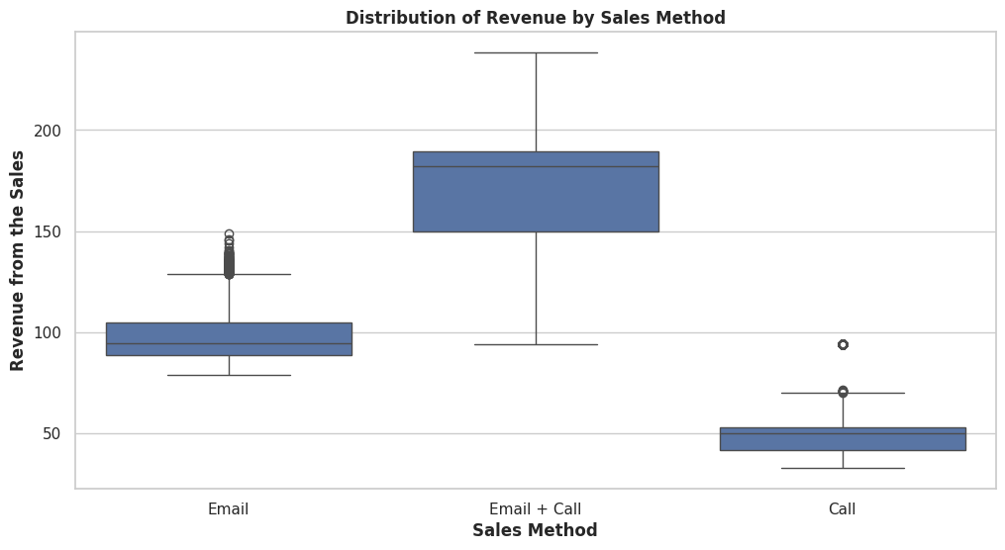
Summary of Key Findings
Based on the boxplot:
Customers approached by both call and email brought in the highest revenue.
Customers approached by email alone generated the next highest revenue.
Customers approached by call alone had the lowest revenue among the three groups.

Slide 9
Business Metrics
Since our goal is to determine which sales method to use in order to increase the revenue and the number of items sold, it is recommended to monitor the following metrics:
Revenue per Week by Sales Method
Number of Products Sold per Week by Sales Method
Initial Values for the metrics based on the current data:
Revenue:
- Call approach: $37
- Email approach: $88
- Both Call and Email approach: $125
Number of Products Sold:
- Call approach: 7
- Email approach: 9
- Both Call and Email approach: 9

Slide 10
Recommendations
Prioritize the combined approach:
Action: Given that the combined approach of email and call generated the highest increase in revenue and led to a higher number of items sold, prioritize this approach for future campaigns.
Monitor Key Metrics:
Metrics to Monitor:
Revenue per Week by Sales Method
Number of Products Sold per Week by Sales Method
Action: Regularly track these metrics to evaluate the perofrmance of different sales methods and make data-driven decisions.
Analyze Customer Spending Patterns:
Action: Further investigate why customers approached by email or call tend to spend less compared to those approached by both methods. This could involve analyzing the effectiveness of each sales approach and customer responses.

Slide 11
Recommendations
Optimize Sales Strategies:
Action: Consider developing targeted strategies for customers approached by email and call alone, such as offering promotions or personalized follow-ups, to increase their spending.
Enhance Call Approach
Action: Reduce the call duration to around 10 minutes per customer and monitor to see if the revenue or the number of items sold increases for the customers approached by call.
Summary:
In conclusion, the combined approach of email and call has proven to be the most effective in terms of revenue increase and number of items sold. The business should focus on enhancing and prioritizing this approach while monitoring key metrics to optimize sales performance. Further analysis into customer spending behavior and refining sales strategies can help maximize revenue and sales outcomes.

